Slide 1
Formatting vs. Rounding
Topic 2
Lesson 1 –Formatting vs. Rounding Numbers

Slide 2
Formatting
Formatting changes the way values are displayed, but does not change the actual value being used in functions.
Common formatting options:
Currency values
Time and date values
Numeric formats and decimal points
Percent

Slide 3
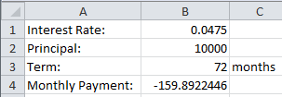
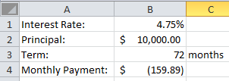
Demo: Formatting
Unformatted values
Percent
Currency
Accounting
Formatted values

Slide 4
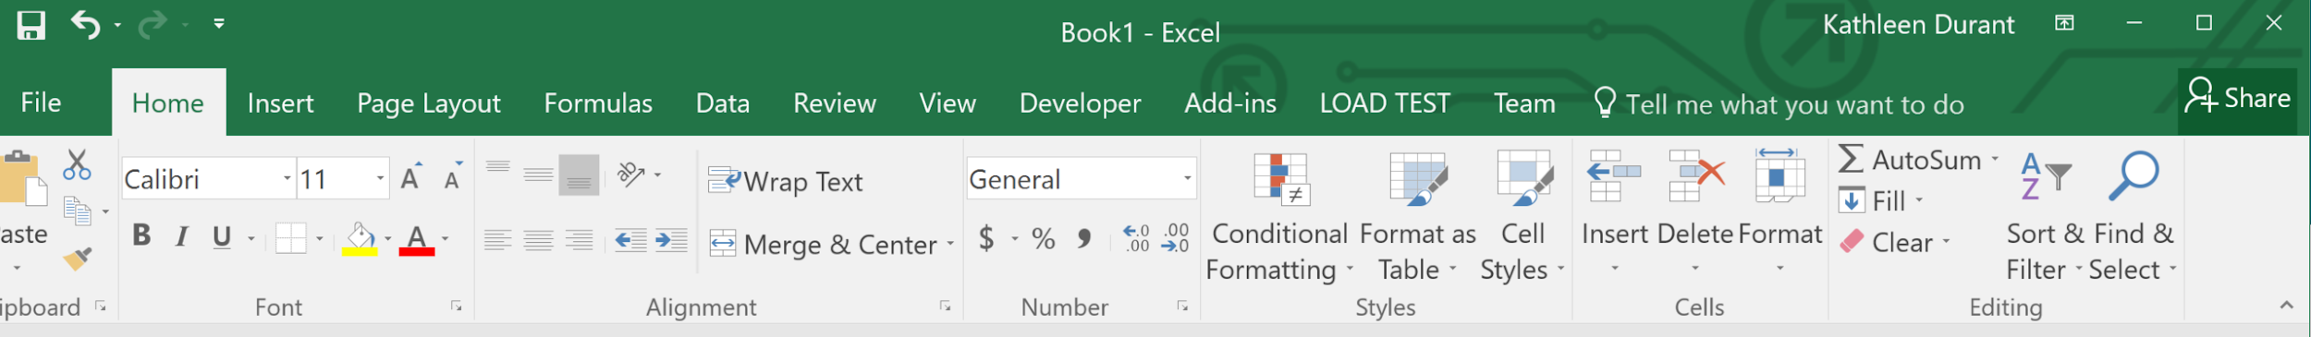
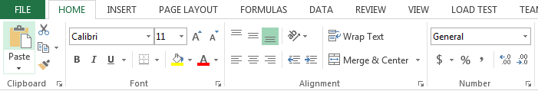
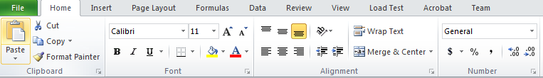
Formatting
2016
2013
2010

Slide 5

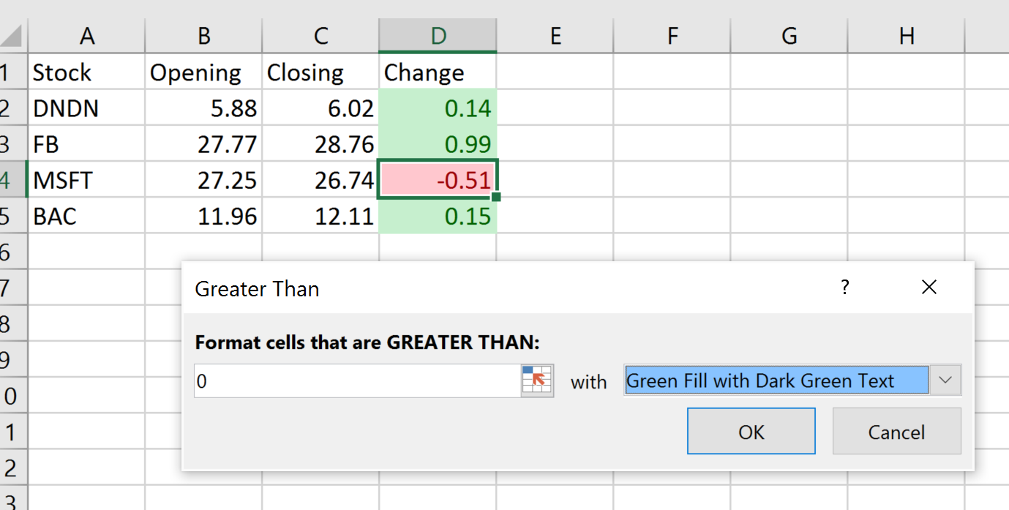
Conditional Formatting
Conditional formatting allows the application to limit formatting when certain conditions are met.
On the Home tab, in the Styles group, click the arrow next to Conditional Formatting

Slide 6
Rounding
Rounding actually changes the value by rounding up or down to some specified accuracy.
The rounded value is copied to another cell.
To round, use the ROUND() function:
=ROUND(A1,2)
=ROUNDUP(A1,2)
Notes:
Note the difference between rounding and formatting precision.

Slide 7
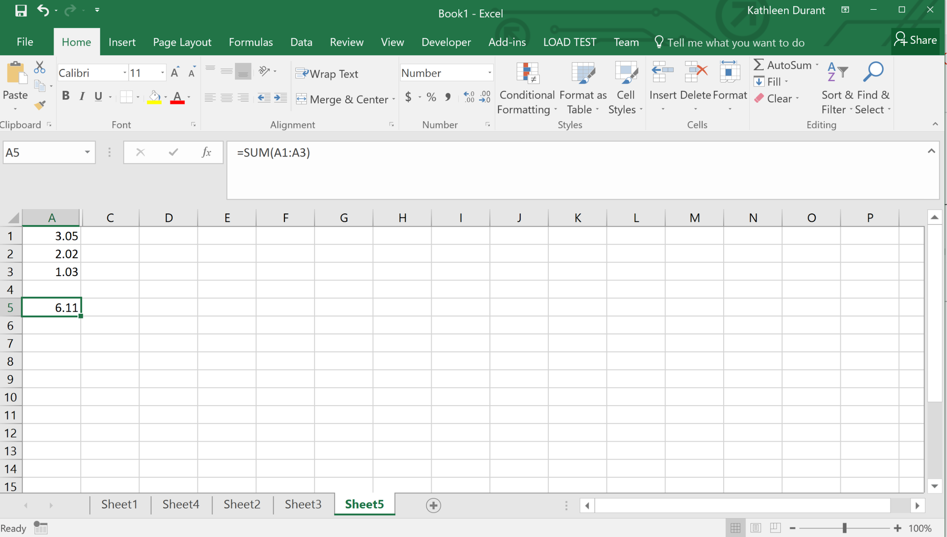
Formatting Example

Slide 8
Look Carefully at the Formatting Example
It appears to say that the sum of
3.05
2.02
1.03
is 6.11
That is not mathematically correct!
The next slide shows what is actually in each cell. (Control +~)

Slide 9
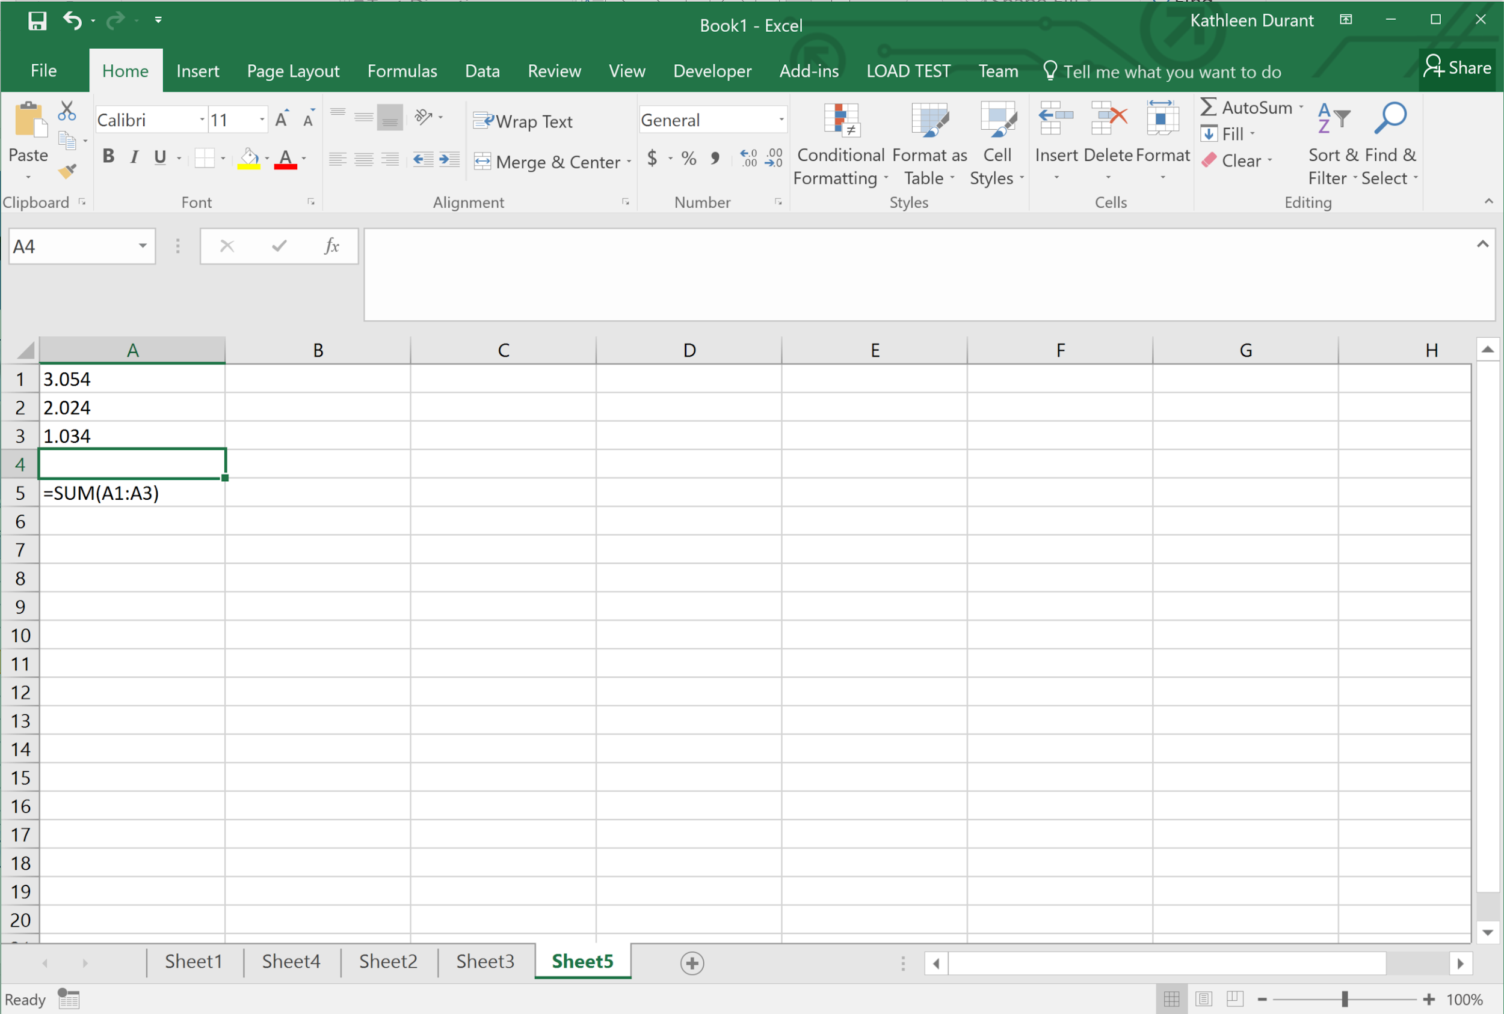
Formatting Example with CTRL+~

Slide 10
What happened?
What happened is that the cells in column ‘A’ were formatted to show only 2 digits after the decimal point.
However, the numbers in column ‘A’ actually had more than 2 digits after the decimal point. The last digits were “hidden”.
Hiding some of the digits can yield results that appear to be wrong.

Slide 11
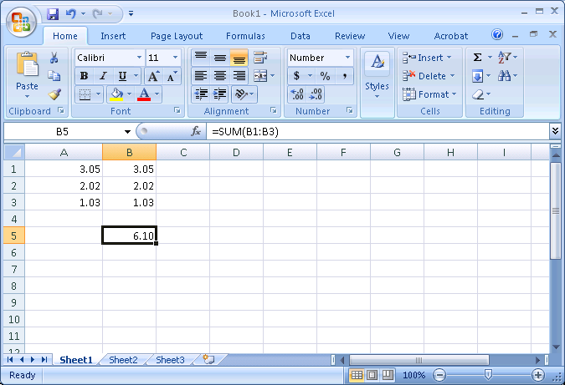
Rounding Example

Slide 12
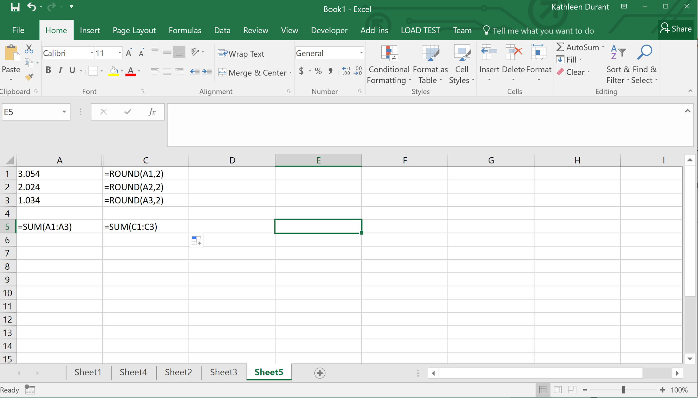
Rounding Example with CTRL+~

Slide 13
Rounding Example
The addition in column ‘B’ is now mathematically correct.
The value that appears in cell B5 is in fact the sum of the numbers appearing in cells B1:B3

Slide 14
Warning!
The values displayed by a computer application are often not the values that are used inside that application.
If you need a value that has only a certain number of digits after the decimal place, you must round that value, not merely format it.
Excel: ROUND(Range, Decimal Places)

Slide 15
Bottom Line
If a computer’s arithmetic appears incorrect, it may be a formatting / rounding error.
Excel: fix these errors with the ROUND function.

Slide 16
Summary
In this module you learned that:
rounding is not the same as formatting
Excel automatically adjusts cell references when copying formulas
Notes:
Note the difference between rounding and formatting precision.

